Slide 1

Algorithms & Pseudocode
CSCI 1101 Introduction to Computer Science

Slide 2
Algorithm
Definition:
A set of finite rules or instructions to be followed in calculations or other problem-solving operations.

Slide 3
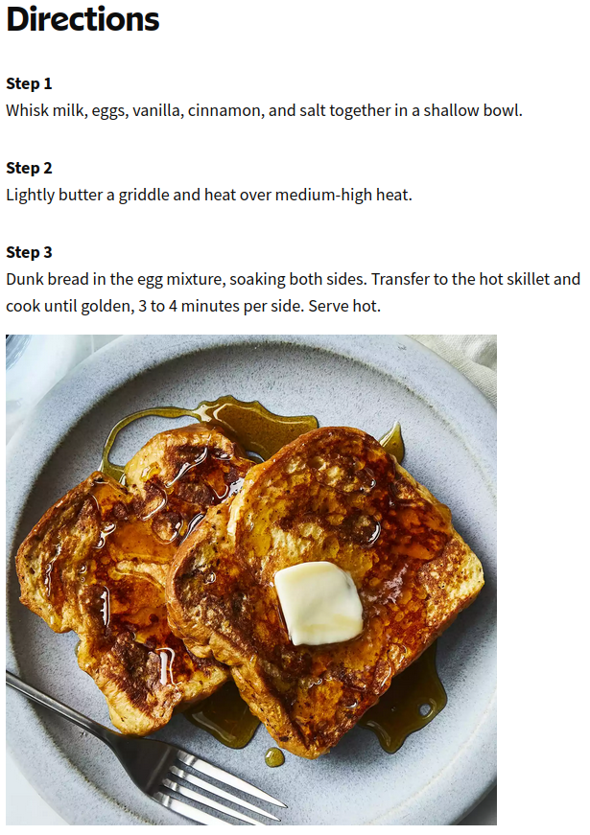
A Simple Algorithm
Examples:
Cookbook
Google Maps

Slide 4
Pseudocode
Definition:
A step-by-step description of an algorithm that does not use any programming language in its representation, but instead it uses the simple English language text.
Pseudocode is the intermediate state between an idea and its implementation(code) in a high-level language.

Slide 5
Pseudocode for Absolute Value Problem
Absolute Value:
Get Number
If Number < 0 then
Multiply Number by -1
Output Number

Slide 6
Pseudocode for Is Positive Problem
Is Positive:
Get Number
If Number > 0 then
Output "It's Positive"
Else
Output "It's Not Positive"

Slide 7
Pseudocode Countdown Problem
Countdown:
Set Count to 3
While Count > 0 do
Output Count
Decrement Count by 1

Slide 8
Problem Solving Strategies
Ask Questions!
What do I know about the problem?
What information do I have to solve the problem?
What does the solution look like?

Slide 9
Problem Solving Strategies
Reuse Solutions. Don't reinvent the wheel!
Similar problems come up again and again.
Recognize tasks that have been solved before and plug in the solution.

Slide 10
Problem Solving Strategies
Divide and Conquer!
Break up a large problem down to smaller problems and solve for each smaller problem.
You can continue to break down a problem over-and-over until each problem is manageable.

Slide 11
Polya's Problem Solving Steps
Understand the problem. (Use problem solving strategies)
Devise a plan for solving the problem. (Pseudocode, use drawings)
Carry out the plan. (Code)
Evaluate your solution's accuracy and its potential for solving other problems.

